Slide 1
Design Pattern in Functional Way
Hemant Kumar Tewtia
10 May 2019

Slide 2
Agenda
Functional Programming Overview
Quick overview (Lambdas and Method References)
Java Functional Interfaces
OOPs Design Patterns in Functional Way
Java Functional libraries
Q&A

Slide 3
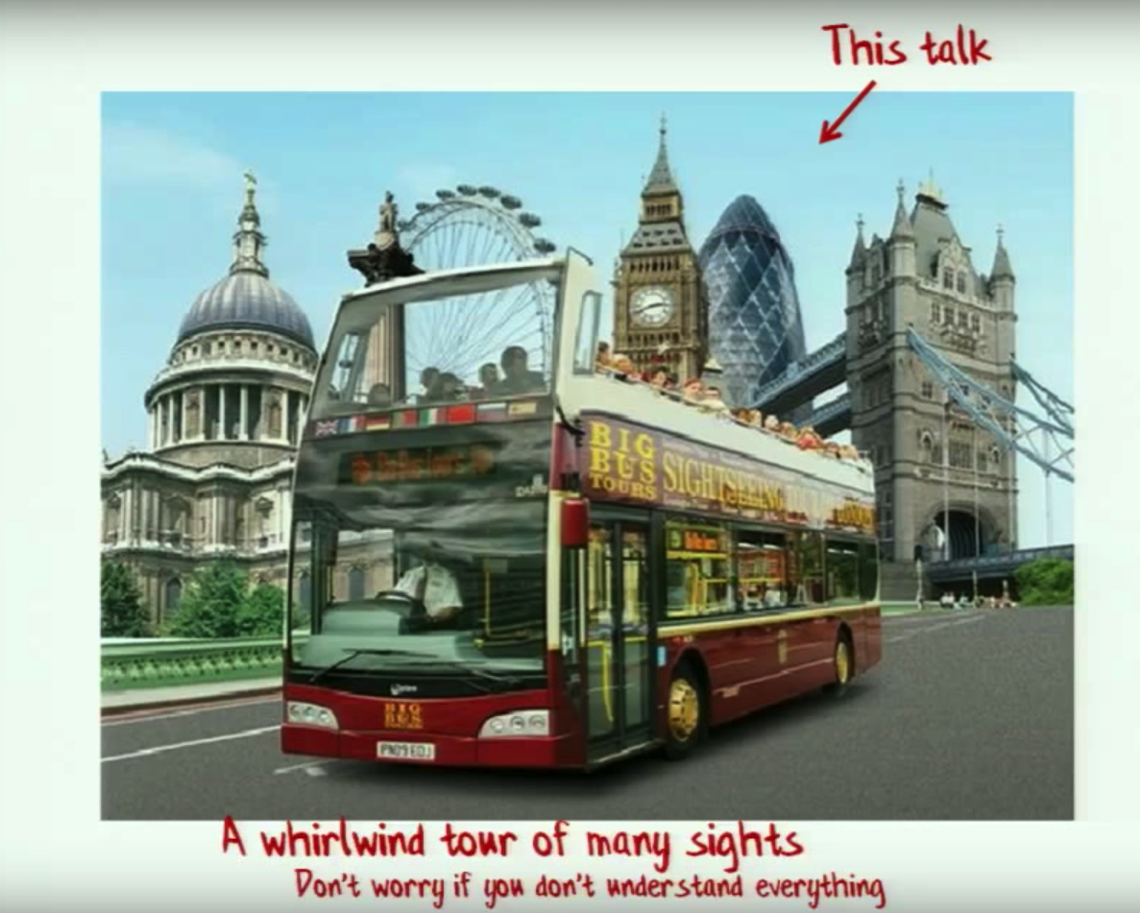

Slide 4
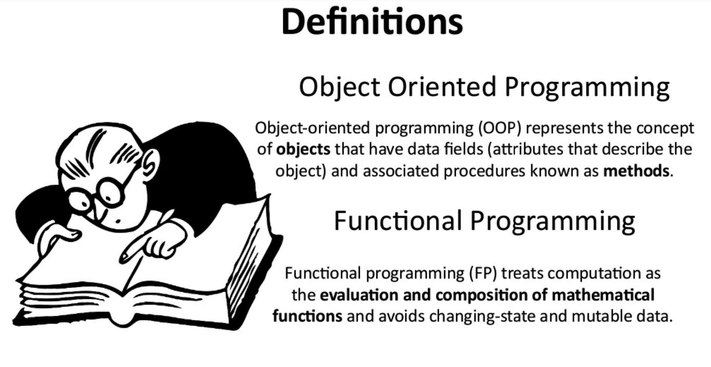
Functional Programming overview

Slide 5
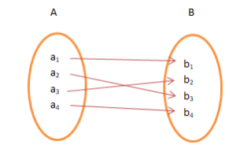
Functional Programming overview
Basic Functional Concepts
Immutable values over mutable values
Functions as first-class values
Currying
Lazy Evaluation

Slide 6
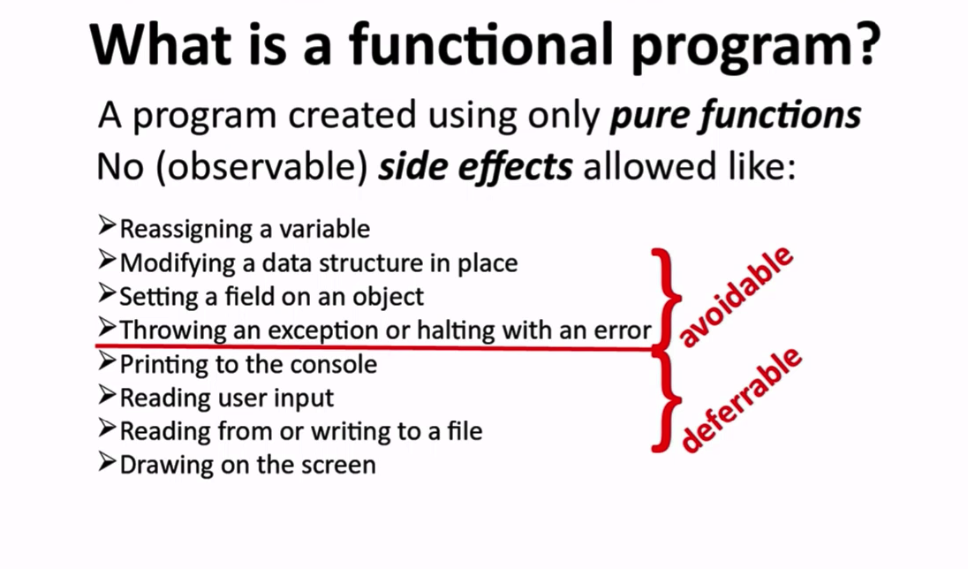
Functional Programming overview

Slide 7
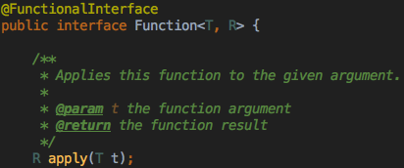
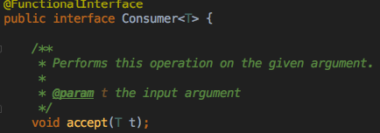
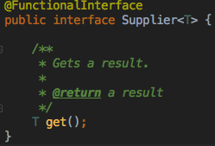
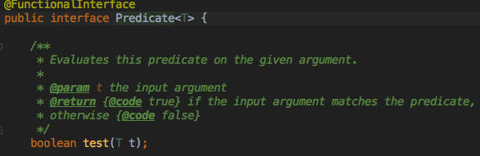
Java Functional Interfaces

Slide 8


